Slide 1
Arc Race
Rexy Agusti (1901508814)
Suci Ariani (1901455871)
Vito widigdo (1901478950)
Dwika Nurachman Aji Laksono (1901498012)
Kevin Ronaldo (1901463122)
Firza Bagus Razdiansyah (1901480053)

Slide 2
Pembagian Tugas
Rexy Agusti (Design Consept,Design Model,Code Ai)
Suci Ariani (Code movement,UI Design)
Kevin Ronaldo (Design Model)
Dwika nurachman aji laksono (Design Track)
Vito widigdo (Design Track)
Firza Bagus R. (Audio and Sfx)

Slide 3
Contents
Game Ide
Game Object
Game World
Game Play
Tools

Slide 4
Game Idea
Circuit Racing Game
Arcade Game
Notes:
REXY AGUSTI

Slide 5
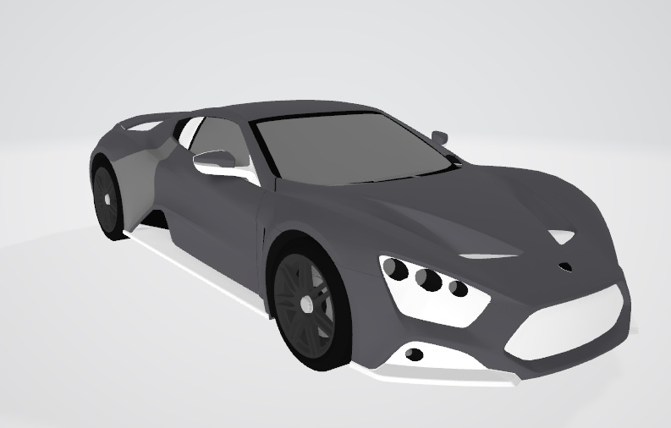
Game Object Car(Example)
Notes:
Kevin Ronaldo

Slide 6
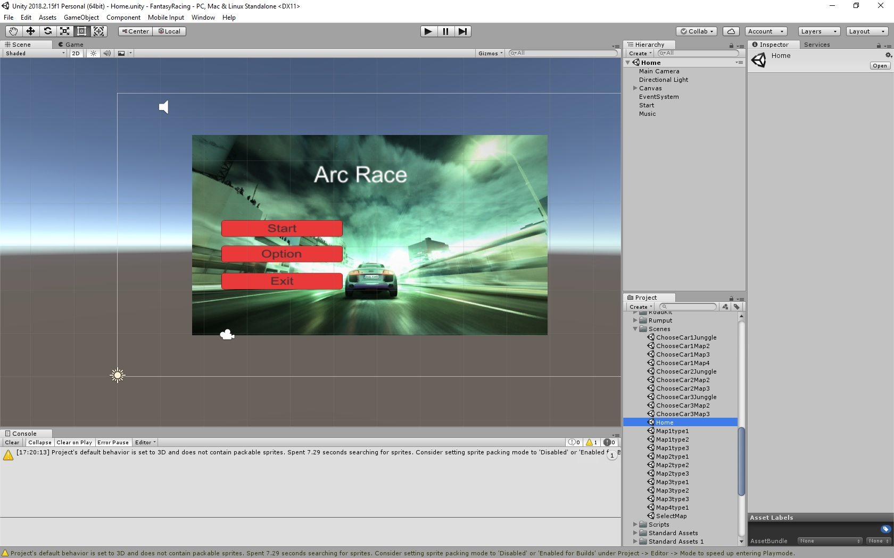
UI Design
HOME SCENE
Notes:
Suci Ariani

Slide 7
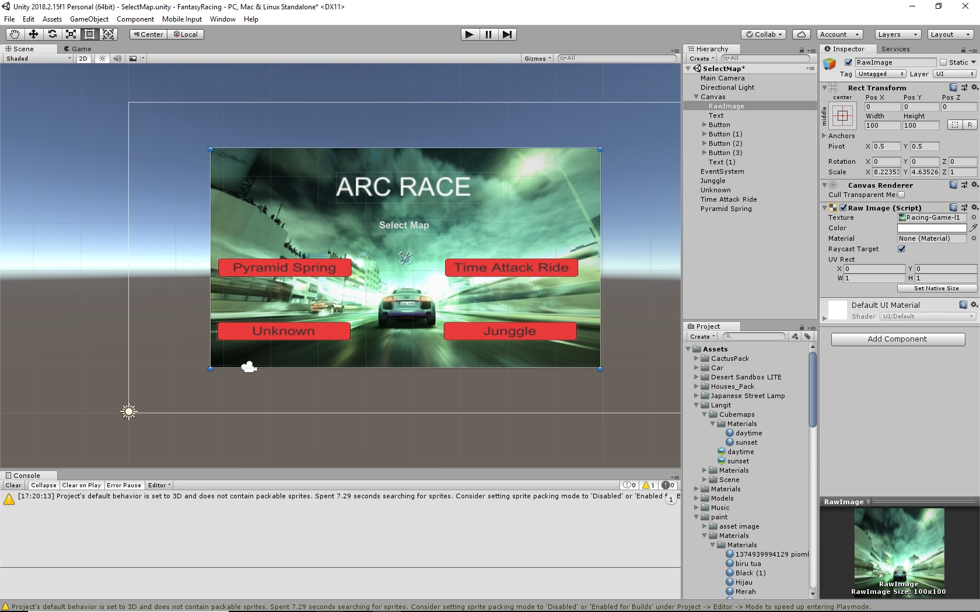
UI Design
Select Track

Slide 8
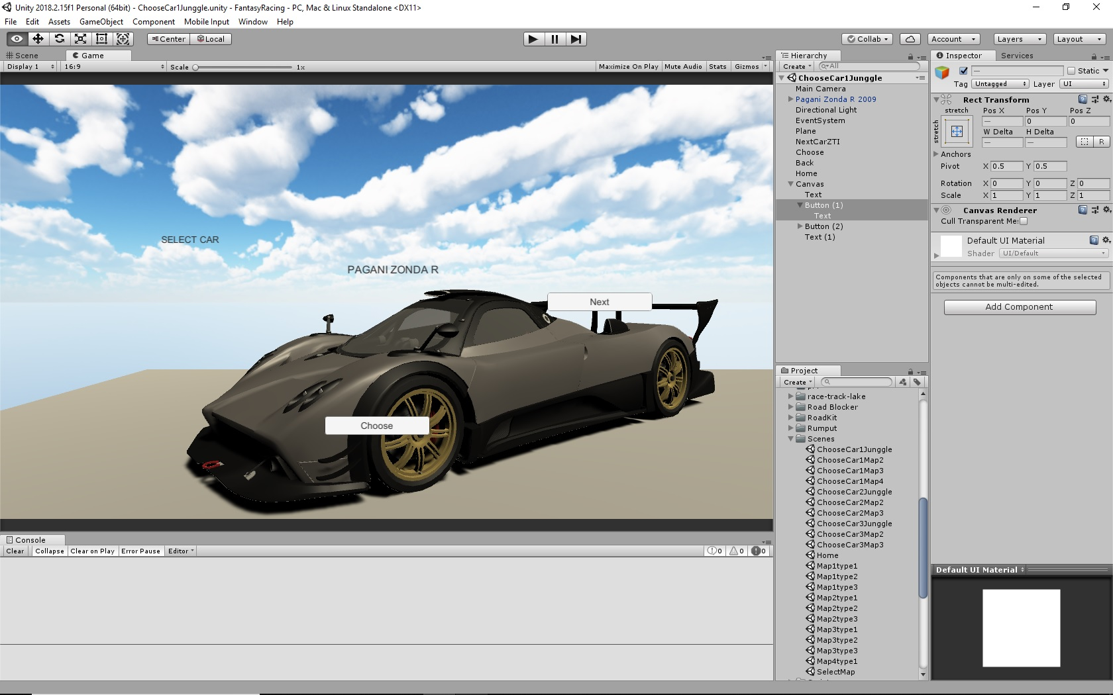
UI Design
Select Car

Slide 9
Game World
Circuit racing mode
and user can upgrade the engine to be a faster and faster. And make you best of driver in the world.
Different map different difficult
Notes:
Rexy Agusti

Slide 10
Game World
First Race
Basic with tutorial how you can play
Second Race and Next Race
Make AI hardest to challenge it and more circuit race.
Notes:
REXY AGUSTI

Slide 11
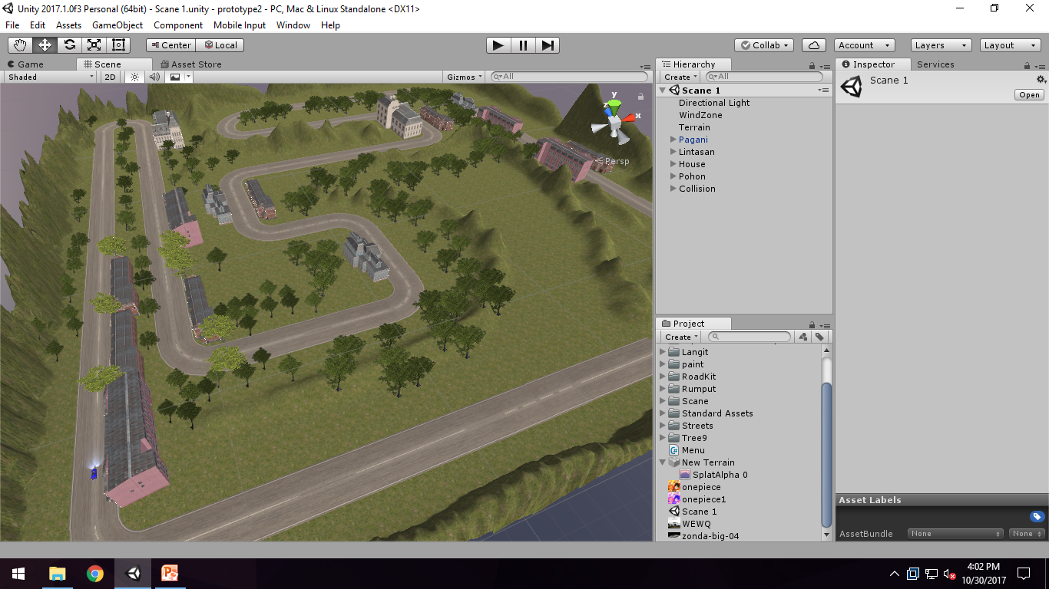
Game World Design
Notes:
Dwika nurachman aji laksono

Slide 12
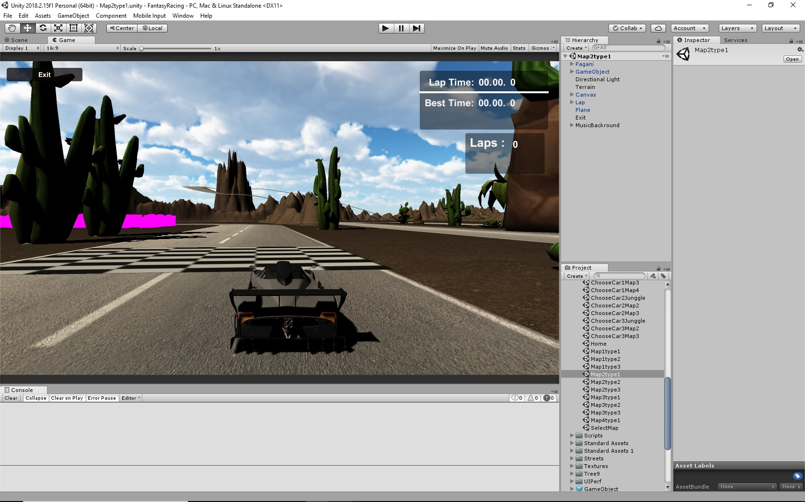
Game World Design
Notes:
Vito widigdo

Slide 13
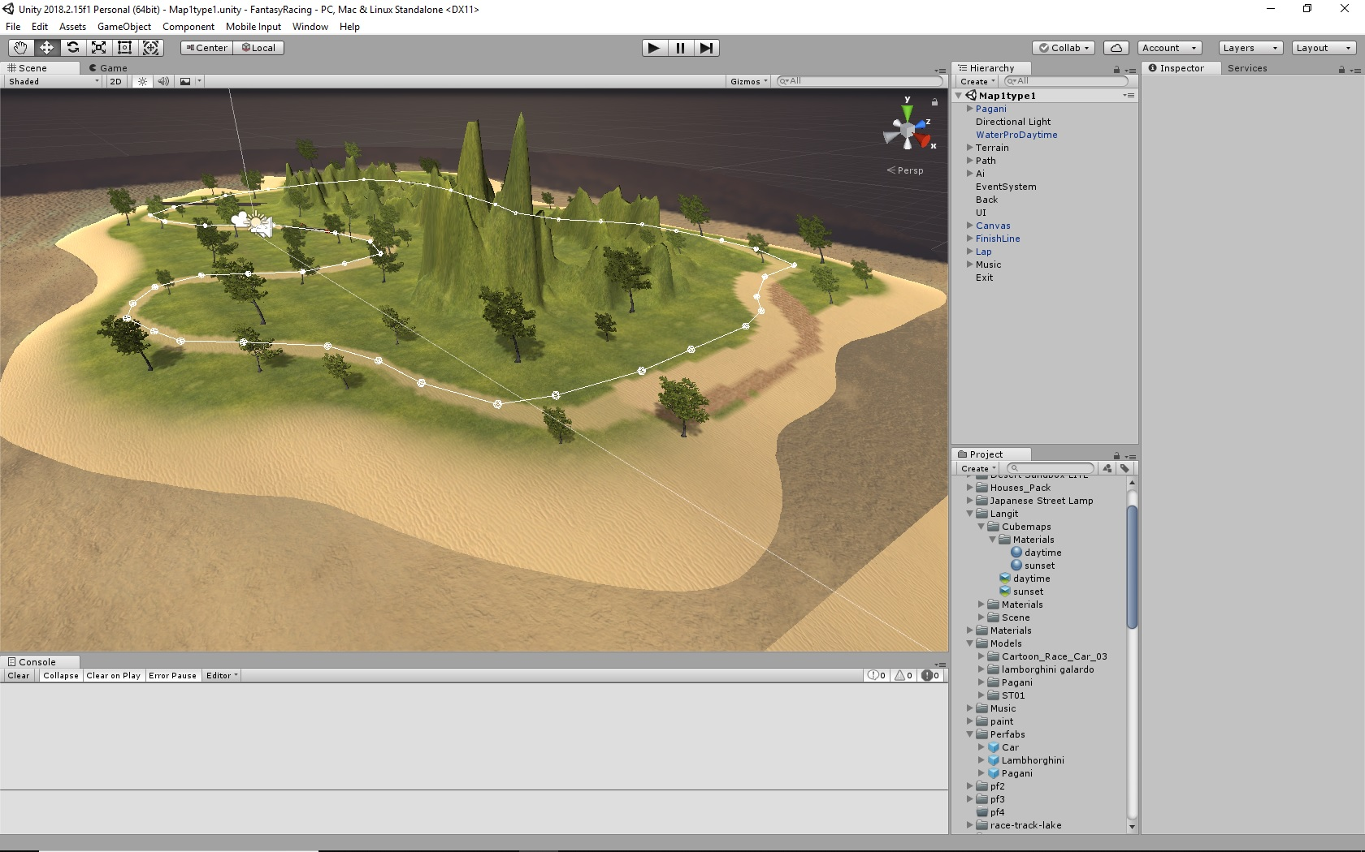
Game World Design

Slide 14
Game Play
User can selected car in a first menu in the game
Using [W] key to accelerate
Using [A] key to turn left
Using [D] key to turn right
Usign [S] key to brake
Player can upgrade engine and Nitrous
Unlock System
Notes:
Suci Ariani

Slide 15
Tools
Using Unity Game Engine
Microsoft Visual Studio 2019 for scripting
Blender for 3D Modeling

Slide 16
Asset List
Asset car
Asset home
Asset tree
Asset road
Asset weather
Asset paint (www.google.com/image/)
Asset grass

Slide 17
Kendala
Susahnya mencari sound FX yang sesuai dengan kendaraan
Scripting
Notes:
Firza

